Slide 1

Data Visualization Using Python
Submitted by:
Koushik Gowda - 10515678
Santosh Vinayaka - 10518683
Goutham Bitra - 10522389
Amith Murali - 1051938

Slide 2
Goals
Explore relationships among variables
Visualize natural groupings or clusters
Tuning the data to get better results
Extract meaningful insights from the data

Slide 3
Data
Datasets used : Clients.csv and Patches.csv
Clients.csv : Information about the clients of a bank
43,193 instances and 9 variables
2 subsets created
Patches.csv : Observations made over different 30m X 30 m patches in the forests of Alberta, Canada.
15,120 instances and 7 variables
3 subsets created

Slide 4
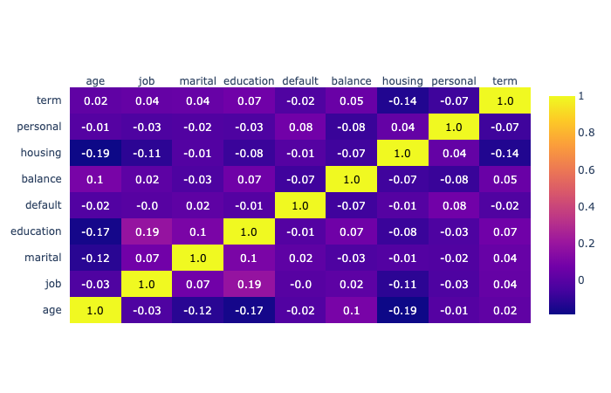
Data Exploration
Correlation heatmap for Clients.csv data set
None of the columns are highly corelated
No columns are dropped

Slide 5
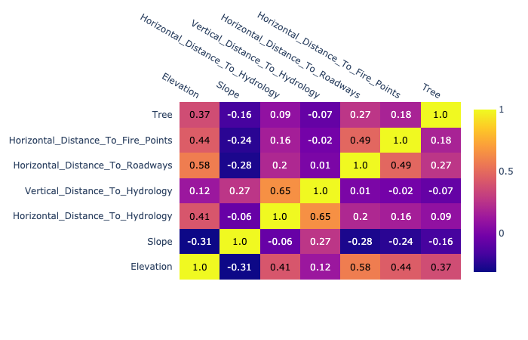
Data Exploration
Correlation heatmap for Patches.csv data set
The column Horizontal distance to hydrology and vertical distance to hydrology have correlation of 0.65.
None of the columns are highly corelated
No columns are dropped

Slide 6
Dimensionality reduction techniques
PCA – Principal control analysis
Linear dimensionality reduction technique
Extracts information from high dimensional space by projecting it to low dimensional sub-space.
Unsupervised dimensionality reduction technique
T-SNE – t-Distributed Stochastic Neighbor Embedding
Non-linear dimensionality reduction technique
Calculates the probability of similar points in both high dimensional and low dimensional space
Tries to minimize the difference of similarities in higher-dimensional and lower dimensional space for a perfect representation of data points in lower dimensional space

Slide 7
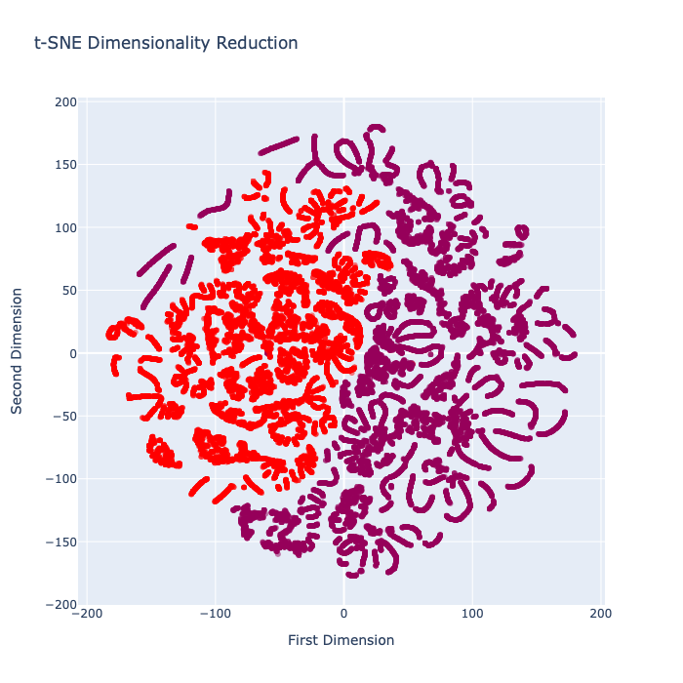
Visualization – Clients.csv
2 Clusters
Red:
Clients with no default Payment history
No history of having any housing loan
Violet:
Clients with no default payment history
Clients who have housing loan
Notes:
There are two clusters in this subset from Clients dataset. The red cluster represents the clients with no payment default history and no history of having any housing loan. Whereas in the violet cluster contains data elements with no default history but the presence of housing loan. In both the clusters the records of bank balance, Job type and age are shown

Slide 8
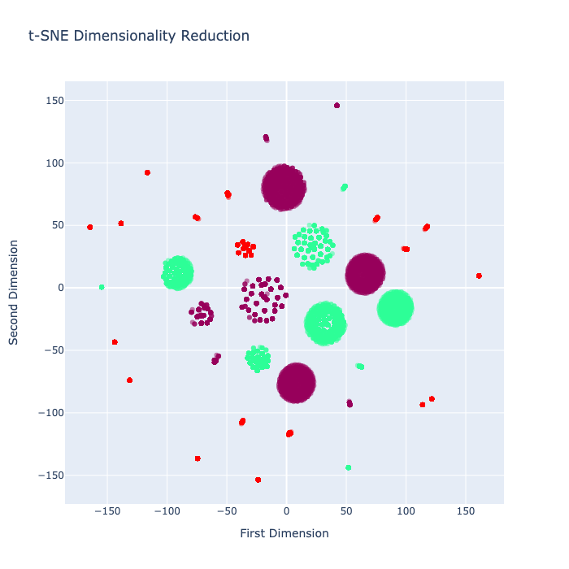
Visualization – Clients.csv
3 clusters
Green
Clients with no housing loan and personal loan
Clustered based on education and marital status
Violet
Clients with mandatory housing loan
Red
Clients with housing loan and personal loan
Mandatory on all the clusters
Notes:
In the subset, clusters are made as per bank clients with housing loan and personal loan which is clustered based on there education level and marital status. Green clusters represent the clients with no housing loan and personal loan, clustered based on the education and marital status. We can further see that majority people with tertiary education level have no housing and personal loan. Violet clusters shows the clients with mandatory housing loan. Most of the people who has housing loan are married or single. Red cluster shows the clients with both housing and personal loan which is mandatory in all the red clusters. It can further show that people with both personal loan and housing loan are married and their education level is secondary.

Slide 9
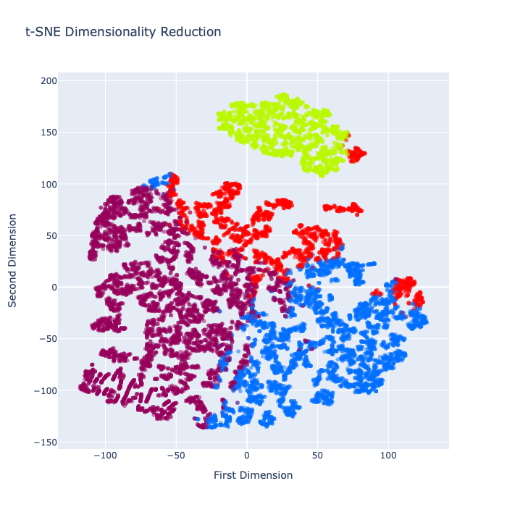
Visualization and insights – Patches.csv
4 clusters
Yellow
Horizontal distance to hydrology is in the range 0-900
Negative values for vertical distance
Red
Horizontal distance to hydrology is in the range 0-800
Has the highest value for vertical distance
Violet
Horizontal distance to hydrology is in the range 0-700
Has the most negative values for vertical distance
Blue
Horizontal distance to hydrology is in the range 0-400
Negative values for vertical distance
Notes:
We have four clusters for subset 1. when we hover into the yellow cluster, it can be interpreted that the horizontal distance to the hydrology is ranging from 0-900, where in the tree represents of the type : Spruce, and the tree type for all other clusters represents : other. The Horizontal distance for the red cluster ranges from 0-800,for the purple it ranges from 0-700, and finally, the range for the blue is from 0-400. We can observe that the horizontal range for the yellow cluster is highest and the is lowest for the blue cluster. Moving on to vertical distance, the purple cluster has the most negative values when compared to the other clusters. The vertical distance remains positive, with the red cluster having the highest values. The yellow, red and purple clusters come under 2000s and 3000s, whereas the blue cluster is within the range of 1000 and 2000. With respect to elevation, Red, yellow and purple have the highest elevation point. The slope for the red and purple clusters ranges from 0 to 25, whereas, the slope for the yellow cluster ranges from 0-29 and the blue ranges between 20s and 30s.
Blue has the highest slope.

Slide 10
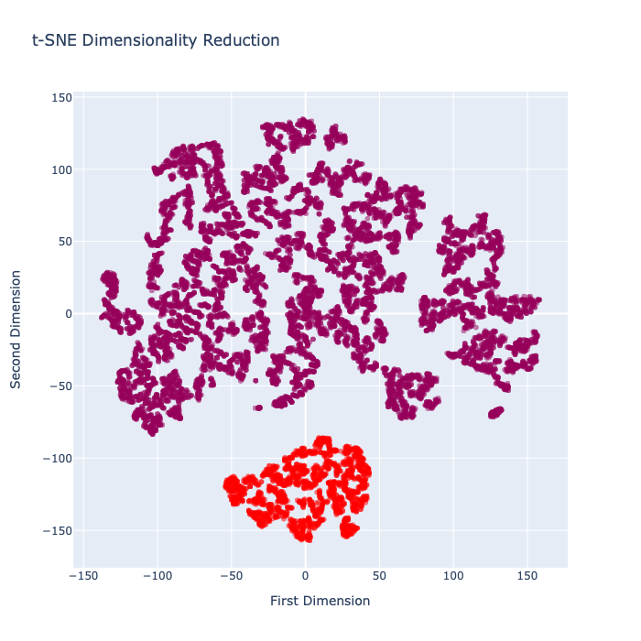
Visualization and insights – Patches.csv
2 clusters
Violet
Represents Tree type : others
Horizontal distance to the roadways ranges from 0-6000
Red
Represents Tree type : Spruce
Horizontal distance to the roadways ranges from 300-6000
Notes:
In the second subset, we can observe that the violet cluster represents the tree type : others, and the red cluster represents the tree type : spruce. It can also be seen that the values of horizontal distance to the roadways ranges from 0-6000 for violet cluster and 300-6000 for the red cluster, representing that the more number of values lie under violet cluster. With respect to elevation point, the violet and the red cluster is within the range of 2000s and 3000s, the only difference is that the 3000s are more in red cluster. We can also observe that the range for slopes for both the clusters are constant.

Slide 11
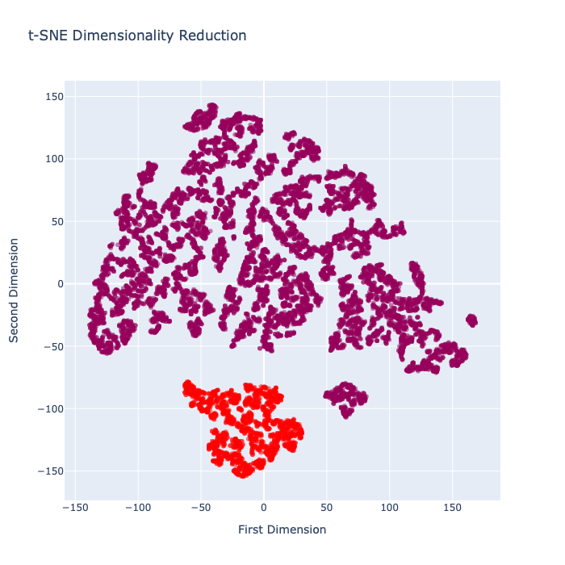
Visualization and insights – Patches.csv
2 clusters
Violet
Represents Tree type : others
Horizontal distance to the roadways ranges from 0-4000
Red
Represents Tree type : Spruce
Horizontal distance to the roadways ranges from 10-6000
Notes:
In the Third subset, we can observe that the violet cluster represents the tree type : others, and the red cluster represents the tree type : spruce. It can further be seen that the values horizontal distance to the roadways ranges from 0-4000 for violet cluster and 10-6000 for the red cluster, representing that the more number of values lie under red cluster. With respect to the elevation point the violet and the red cluster comes under 2000s and 3000s, showing most of the points under 2000s, only difference is that the 3000s are more in red cluster. Finally, the range for slopes for the violet cluster ranges from 1-46, and the range for red cluster comes between 1-30.

